Slide 1

Welcome to join Harbor Community Conference Call
05:00-06:00 AM (PDT) /
21:00-22:00 (Beijing Time)
2018/11/07 Wednesday
https://zoom.us/j/734959521
Twitter
Maillist
Slack (slack.cncf.io)
@project_harbor
harbor-users@googlegroups.com
#harbor
#harbor-dev
harbor-dev@googlegroups.com

Slide 2
Agenda
Harbor related(10 mins)
Demo: HA by Harbor Helm Chart (20 mins)
Demo: UI of build history and retag (5 mins)
Any other topics from community (15 mins)

Slide 3
Development Progress
V1.7.0
Contributed by VMware Harbor
Online GC – Ready
Documenting user guide
Helm Chart repository enhancement - Ready
Delete Chart (all chart versions)
Download latest chart version from chart view
Mark labels to charts
Chart counts in project
HA by Harbor Helm Chart - Ongoing
Under verification testing
Upgrade migration under working
Contributed by CaiCloud （@Ca1989) - Ready
Retag (复制镜像)
PR #5995 & #5779
Contributed by 360 Company (@kofj) - Ready
Image build history
PR #5371
V1.6.1 Released
Bump Clair to V2.0.6 to fix CVE URL change issue

Slide 4
CNCF and community related
Governance model is enabled
- Working on enabling some flow control tools
CI/CD pipeline refactoring to follow CNCF best practice
Proposal PR: https://github.com/goharbor/community/pull/8

Slide 5
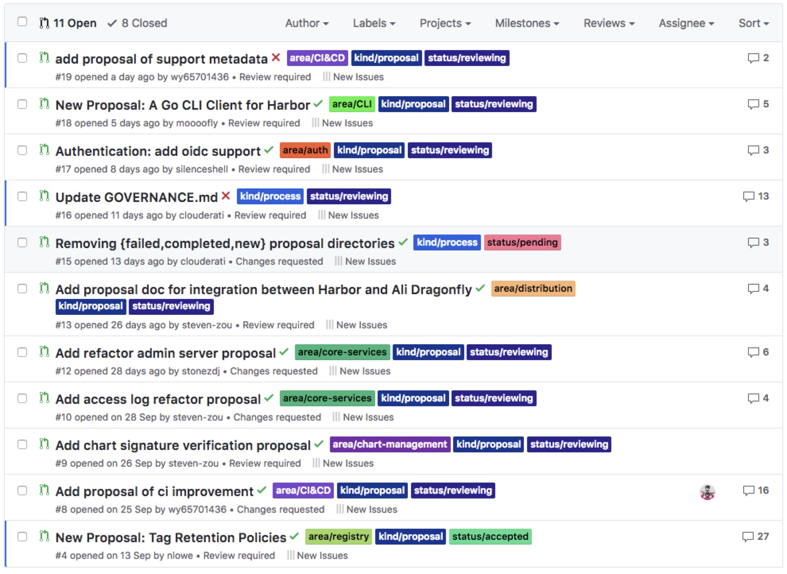
Proposals
Proposals: https://github.com/goharbor/community/pulls

Slide 6
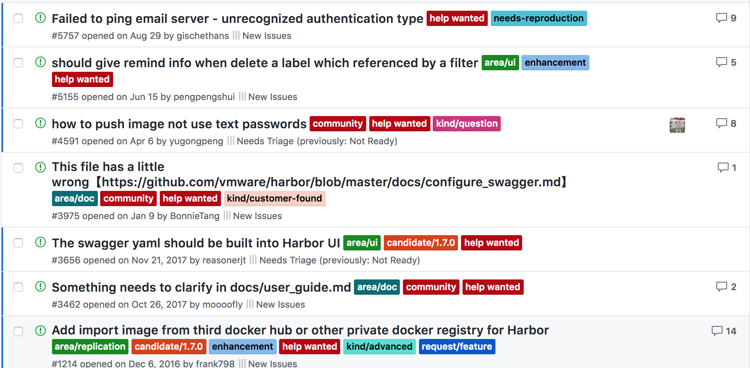
Help wanted
Pick up a `help wanted` issue as a good start to do contributions to Harbor community!

Slide 7
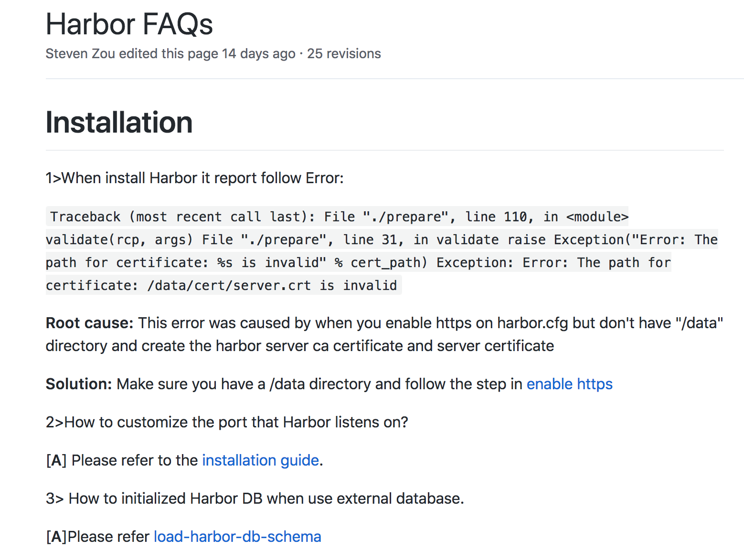
FAQ updates
If you resolve a problem with a solution and that may be benefit to other community members, please add it to the FAQ list!
https://github.com/goharbor/harbor/wiki/Harbor-FAQs

Slide 8
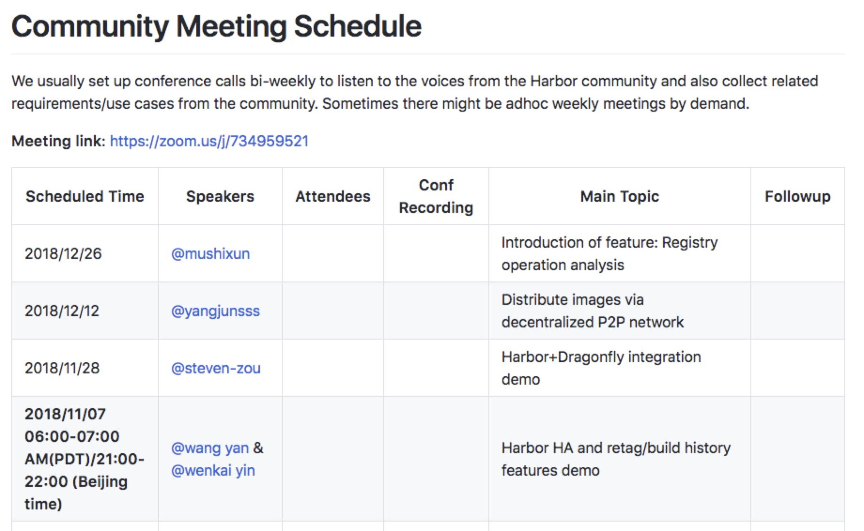
Meeting Topics
If you want to propose meeting topics, go ahead to update the meeting schedule md document and raise PR.
https://github.com/goharbor/community/blob/master/MEETING_SCHEDULE.md
￼

Slide 9
KubeCon Shanghai
Sessions:
Nov 13, 10:55 Using BOSH to Deploy Harbor Registry of Cloud Foundry Day – Jesse Hu, Daojun Zhang
Nov 13, 14:00 Kubernetes Workshop with VMware (Harbor session) – Henry Zhang, Steven Zou
Nov 13, 16:35 From Enterprise Image Registry to Chart Repo – Daniel Jiang
Nov 14, 11:50 Harbor Introduction – Henry Zhang, Steven Zou
Nov 15, 12:15 Harbor Deep Dive – Daniel Jiang, Steven Zou
Activities:
CNCF Harbor China Community Reception & Award Ceremony: Nov 13 evening. https://events.linuxfoundation.cn/events/kubecon-cloudnativecon-china-2018/schedule-english/
Please follow or join our Twitter(@Project_harbor), slack, wechat, email groups to stay in touch for the latest event update.
Goodies:
KubeCon Shanghai registration, 25% discount code for Harbor users: KCCN18COMHAR
Harbor contributors get free registration. Please refer to registration web site for details.

Slide 10
V1.7 early preview – Helm Chart
Welcome WK!

Slide 11
Topics?
Any topics to discuss here?

Slide 12
Meeting minutes
Meeting is recorded and the recording link will be updated to the meeting schedule doc later: https://github.com/goharbor/community/blob/master/MEETING_SCHEDULE.md
The meeting slides will be uploaded to the community repo https://github.com/goharbor/community and put under the ‘conf-calls’ folder.

